Slide 1


Step 1
Step 2
Step 3

Slide 2
add
plus
sum
and
Addition
total
altogether
more
increase

Slide 3
Addition Calculation
6 + 2 = 8
add
equals
addend addend sum

Slide 4
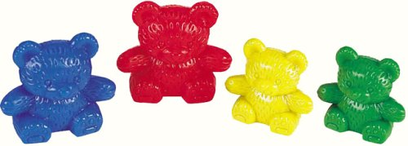
Adding 1 more
Adding 1 more within 10 and then 20
1 2 3 4 5 6 7 8 9 10
11 12 13 14 15 16 17 18 19 20
Problem:
What is one more than 7?
Vocabulary
More

Slide 5





Adding with objects

Slide 6


Adding on a number line
Start at 3 and make 4 jumps.
0
7
1
2
3
4
5
6
Start at 2 and make 8 jumps.
0
10
1
2
3
4
5
6
7
8
9

Slide 7

Number bonds 1 to 4
Additions |  | Subtractions
1+0=1 | 0+1=1 | 1-0=1 | 1-1=0
2+0=2 | 0+2=2 | 2-0=2 | 2-2=0
1+1=2 | 1+1=2 | 2-1=1 | 2-1=1
3+0=3 | 0+3=3 | 3-0=3 | 3-3=0
2+1=3 | 1+2=3 | 3-2=1 | 3-1=2
4+0=4 | 0+4=4 | 4-0=4 | 4-4=0
3+1=4 | 1+3=4 | 4-1=3 | 4-3=1
2+2=4 | 2+2=4 | 4-2=2 | 4-2=2
Vocabulary
Number bonds (Pairs)
Add
Subtract
Equals
Altogether
Makes
More
Total
Can you learn each set one at a time?

Slide 8
Number bonds 5 to 7
Vocabulary
Number bonds (Pairs)
Add
Subtract
Equals
Number bonds (Pairs)
Add
Subtract
Equals
Altogether
Makes
More
Total
Additions |  | Subtractions
5+0=5 | 0+5=5 | 5-0=5 | 5-5=0
4+1=5 | 1+4=5 | 5-1=4 | 5-4=1
3+2=5 | 2+3=5 | 5-2=3 | 5-3=2
6+0=6 | 0+6=6 | 6-0=6 | 6-6=0
5+1=6 | 1+5=6 | 6-1=5 | 6-5=1
4+2=6 | 2+4=6 | 6-2=4 | 6-4=2
3+3=6 | 3+3=6 | 6-3=3 | 6-3=3
7+0=7 | 0+7=7 | 7-0=7 | 7-7=0
6+1=7 | 1+6=7 | 7-1=6 | 7-6=1
5+2=7 | 2+5=7 | 7-2=5 | 7-5=2
3+4=7 | 4+3=7 | 7-3=4 | 7-4=3
Can you learn each set one at a time?

Slide 9
Number bonds 8 & 9
Vocabulary
Number bonds (Pairs)
Add
Subtract
Equals
Number bonds (Pairs)
Add
Subtract
Equals
Altogether
Makes
More
Total
Additions |  | Subtractions
8+0=8 | 0+8=8 | 8-0=8 | 8-8=0
7+1=8 | 1+7=8 | 8-1=7 | 8-7=1
6+2=8 | 2+6=8 | 8-2=6 | 8-6=2
5+3=8 | 3+5=8 | 8-3=5 | 8-5=3
4+4=8 | 4+4=8 | 8-4=4 | 8-4=4
9+0=9 | 0+9=9 | 9-0=9 | 9-9=0
8+1=9 | 1+8=9 | 9-1=8 | 9-8=1
7+2=9 | 2+7=9 | 9-2=7 | 9-7=2
6+3=9 | 3+6=9 | 9-3=6 | 9-6=3
5+4=9 | 4+5=9 | 9-4=5 | 9-5=4
Can you learn each set one at a time?

Slide 10
Number bonds to 10
Additions |  | Subtractions
10+0=10 | 0+10=10 | 10-0=10 | 10-10=0
9+1=10 | 1+9=10 | 10-1=9 | 10-9=1
8+2=10 | 2+8=10 | 10-2=8 | 10-8=2
7+3=10 | 3+7=10 | 10-3=7 | 10-7=3
6+4=10 | 4+6=10 | 10-4=6 | 10-6=4
5+5=10 | 5+5=10 | 10-5=5 | 10-5=5
Vocabulary
Number bonds (Pairs)
Add
Subtract
Equals
Number bonds (Pairs)
Add
Subtract
Equals
Altogether
Makes
More
Total
Can you say all 11 number bonds with your eyes closed? (Think of the order.)

Slide 11
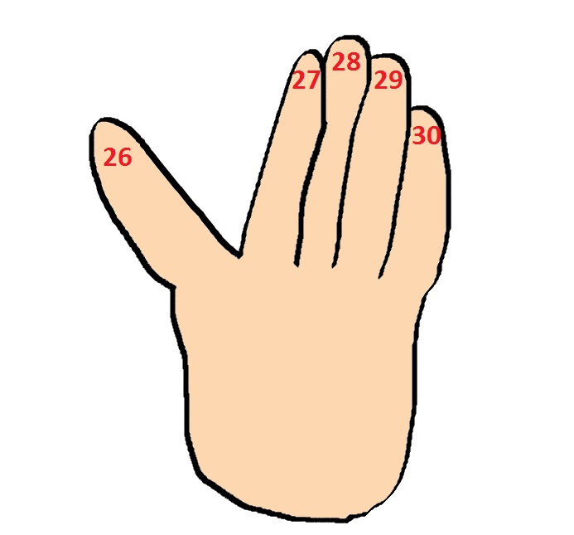

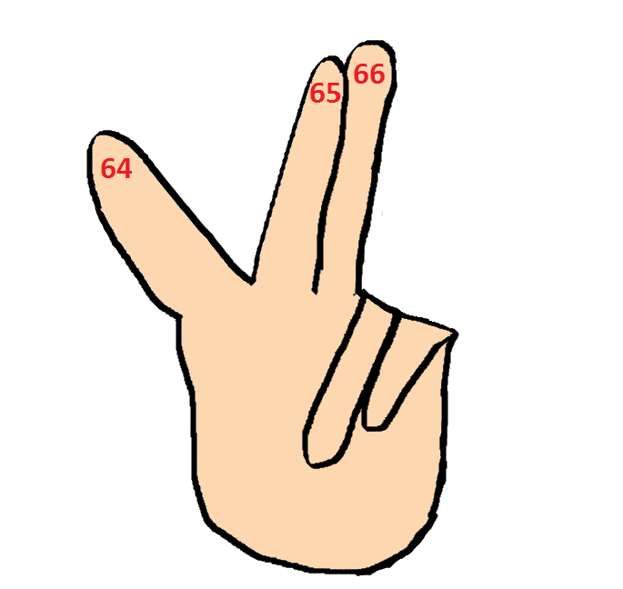

Add a small number to a large number using fingers.
14 + 3 = 17
25
Tip: always start with the large number
63
Vocabulary
Add on
Equals
Can you add 4 to 48?

Slide 12

Adding a small number to a 2-digit number
+4
63
64
65
66
67
Vocabulary
Add on
Equals
Can you add 58 add on 5?

Slide 13
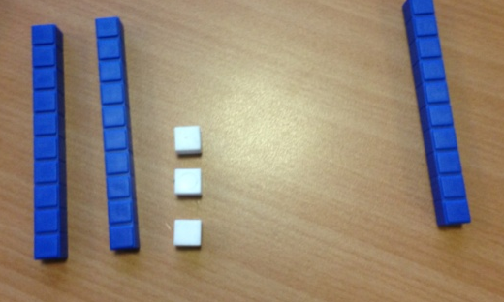
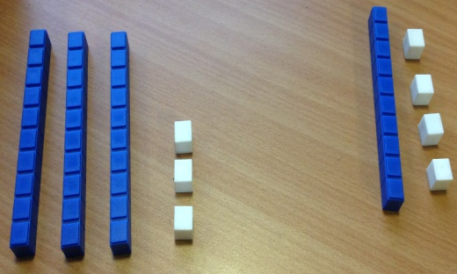


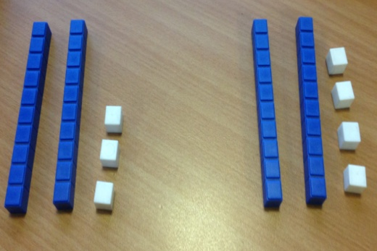
Adding two simple 2-digit numbers
23+10=33
33+14=47
Vocabulary
Add
Equals
Tens
ones
Can you add 32 to 26?
23+24=47

Slide 14

Adding 10 using a number square
1 | 2 | 3 | 4 | 5 | 6 | 7 | 8 | 9 | 10
11 | 12 | 13 | 14 | 15 | 16 | 17 | 18 | 19 | 20
21 | 22 | 23 | 24 | 25 | 26 | 27 | 28 | 29 | 30
31 | 32 | 33 | 34 | 35 | 36 | 37 | 38 | 39 | 40
41 | 42 | 43 | 44 | 45 | 46 | 47 | 48 | 49 | 50
51 | 52 | 53 | 54 | 55 | 56 | 57 | 58 | 59 | 60
61 | 62 | 63 | 64 | 65 | 66 | 67 | 68 | 69 | 70
71 | 72 | 73 | 74 | 75 | 76 | 77 | 78 | 79 | 80
81 | 82 | 83 | 84 | 85 | 86 | 87 | 88 | 89 | 90
91 | 92 | 93 | 94 | 95 | 96 | 97 | 98 | 99 | 100
When adding 10 you count ten squares from your starting number.
Now try 56+10=
Make some up yourself.
Or you can jump to the number directly below.

Slide 15

Plus 10
Tip: remember the ones and add on the 10
41+10=51
Can you add 10 again?
39 +10+10+10=
Vocabulary
Add
Plus
Equals

Slide 16

Adding two 2-digit numbers
1 | 2 | 3 | 4 | 5 | 6 | 7 | 8 | 9 | 10
11 | 12 | 13 | 14 | 15 | 16 | 17 | 18 | 19 | 20
21 | 22 | 23 | 24 | 25 | 26 | 27 | 28 | 29 | 30
31 | 32 | 33 | 34 | 35 | 36 | 37 | 38 | 39 | 40
41 | 42 | 43 | 44 | 45 | 46 | 47 | 48 | 49 | 50
51 | 52 | 53 | 54 | 55 | 56 | 57 | 58 | 59 | 60
61 | 62 | 63 | 64 | 65 | 66 | 67 | 68 | 69 | 70
71 | 72 | 73 | 74 | 75 | 76 | 77 | 78 | 79 | 80
81 | 82 | 83 | 84 | 85 | 86 | 87 | 88 | 89 | 90
91 | 92 | 93 | 94 | 95 | 96 | 97 | 98 | 99 | 100
Tip: tens go up and down; ones go across
Try: 46+32=
With this calculation you can add two 10s (so 2 big jumps below). Then add 3 ones by jumping across 3.

Slide 17
Adding a single digit to a 2-digit number bridging 10
Vocabulary
Add
Equals
Tens
ones
64 + 8=
4+8=12
Work out the units first.
Then use your total
to add to the remaining numbers
60+12=72

Slide 18

Adding any two 2 digit numbers
First add your tens
50+40=90
Then add your units
9+7=16
Tip: first add tens, then units, then add them all together.
Vocabulary
Add
Total
Equals
Tens
Ones
90+16=106

Slide 19

Bridging the 10 with 2 digit numbers.
+10
+4
63
77
73
Vocabulary
Add
Total
Equals
Tens
ones
First add 10
Try: 57+35=
Then add the remaining ones

Slide 20

Adding two 3 digit
numbers not bridging
Vocabulary
Add
Total
Equals
Tens
Hundreds
Ones
How I worked this out
241+123=364
200+100=300
40+20=60
1+3=4
300+60+4=364
Try: 362+124=

Slide 21
Plus 100
.
4357 + 100=
300+100=400
Try: 3742+100+100=
Vocabulary
Add
Thousands
Equals
Tens
Hundreds
Ones
4357+100=4457

Slide 22
Adding two 3-digit numbers bridging ones or tens
743
+ 676
9
+ 110
1300
1419
(3+6)
(40+70)
(700+600)

Slide 23
Adding two 3-digit numbers bridging both tens and ones
869
+ 743
1612
Tip: Remember to start at the ones
9+3=12
60+40=100
800+700=1500
1
1
Always start on the right hand side.

Slide 24
Adding 2 numbers with 2 decimal points that bridge the tenths and hundredths
How I worked this out:
12.53
+ 9.89
22.42
0.03+0.09=0.12
0.5+0.8=1.3
2+9+10=21
0.12+1.3+21=22.42
1
1
1
Always start on the right hand side.

Slide 25
Number Bonds
It is important that you know your number bonds to many different numbers not just 10, 20 and 100!

Slide 26
Number Bonds to 20
Addition |  | Subtraction
20 + 0 = 20 | 0 + 20 = 20 | 20 – 0 = 20 | 20 – 20 = 0
19 + 1 = 20 | 1 + 19 = 20 | 20 – 1 = 19 | 20 - 19 = 1
18 + 2 =20 | 2 + 18 = 20 | 20 – 2 = 18 | 20 – 18 =2
17 + 3 = 20 | 3 + 17 = 20 | 20 – 3 = 17 | 20 – 17 = 3
16 + 4 = 20 | 4 + 16 = 20 | 20 – 4 = 16 | 20 - 16 = 4
15 + 5 = 20 | 5 + 15 = 20 | 20 – 5 = 15 | 20 – 15 = 5
14 + 6 = 20 | 6 + 14 = 20 | 20 – 6 = 14 | 20 – 14 = 6
13 + 7 = 20 | 7 + 13 = 20 | 20 – 7 = 13 | 20 – 13 = 7
12 + 8 = 20 | 8 + 12 = 20 | 20 – 8 = 12 | 20 – 12 = 8
11 + 9 = 20 | 9 + 11 = 20 | 20 – 9 =11 | 20 – 11 =9
10 + 10 = 20 | 10 + 10 = 20 | 20 – 10 = 10 | 20 – 10 =10

Slide 27
Number Bonds to 11
Addition |  | Subtraction
11 + 0 = 11 | 0 + 11 = 11 | 11 – 11 = 0 | 11 – 0 = 11
10 + 1 = 11 | 1 + 10 = 11 | 11 – 10 = 1 | 11 – 1 = 10
9 + 2 = 11 | 2 + 9 = 11 | 11 – 9 = 2 | 11 – 2 = 9
8 + 3 =11 | 3 + 8 = 11 | 11 – 8 = 3 | 11 – 3 = 8
7 + 4 = 11 | 4+ 7 = 11 | 11 – 7 = 4 | 11 – 4 = 7
6+ 5 = 11 | 5 + 6 = 11 | 11 – 6 = 5 | 11 – 5 = 6

Slide 28
Number Bonds to 12
Addition |  | Subtraction
12 + 0 = 12 | 0 + 12 = 12 | 12 – 12 = 0 | 12 – 0 = 12
11 + 1 = 12 | 1 + 11 = 12 | 12 – 11 = 1 | 12 – 1 = 11
10 + 2 = 12 | 2 + 10 = 12 | 12 – 10 = 2 | 12 – 2 = 10
9 + 3 = 12 | 3 + 9 = 12 | 12 – 9 = 3 | 12 – 3 = 9
8 + 4 = 12 | 4 + 8 =. 12 | 12 – 8 = 4 | 12 – 4 = 8
7 + 5 = 12 | 5 + 7 = 12 | 12 – 7 = 5 | 12 – 5 = 7
6 + 6 = 12 | 6 + 6 = 12 | 12 – 6 = 6 | 12 – 6 =6

Slide 29
Number Bonds to 13
Addition |  | Subtraction
13 + 0 = 13 | 0 + 13 = 13 | 13 – 13 = 0 | 13 – 0 = 13
12 + 1 = 13 | 1 + 12 = 13 | 13 – 12 = 1 | 13 – 1 = 12
11 + 2 = 13 | 2 + 11 = 13 | 13 – 11 = 2 | 13 – 2 = 11
10 + 3 = 13 | 3 + 10 = 13 | 13 – 10 = 3 | 13 – 3 = 10
9 + 4 = 13 | 4 + 9 = 13 | 13 – 9 = 4 | 13 – 4 = 9
8 + 5 = 13 | 5 + 8 = 13 | 13 – 8 = 5 | 13 – 5 = 8
7 + 6 = 13 | 6 + 7 = 13 | 13 – 7 = 6 | 13 – 6 = 7

Slide 30
Number Bonds to 14
Addition |  | Subtraction
14 + 0 =14 | 0 + 14 = 14 | 14 – 0 = 14 | 14 – 14 = 0
13 + 1 = 14 | 1 + 13 = 14 | 14 – 1 = 13 | 14 – 13 = 1
12 + 2 = 14 | 2 + 12 = 14 | 14 – 2 = 12 | 14 – 12 = 2
11 + 3 = 14 | 3 + 11 = 14 | 14 – 3 = 11 | 14 – 11 = 3
10 + 4 = 14 | 4 + 10 = 14 | 14 – 4 = 10 | 14 – 10 = 4
9 + 5 = 14 | 5 + 9 = 14 | 14 – 5 = 9 | 14 – 9 = 5
8 + 6 = 14 | 6 + 8 = 14 | 14 – 6 = 8 | 14 – 8 = 6
7 + 7 = 14 | 7 + 7 = 14 | 14 – 7 =7 | 14 – 7 = 7

Slide 31
Number Bonds to 15
Addition |  | Subtraction
15 + 0 = 15 | 0 + 15 = 15 | 15 – 0 =15 | 15 – 15 = 0
14 + 1 = 15 | 1 + 14= 15 | 15 – 1 = 14 | 15 – 14 = 1
13 + 2 = 15 | 2 + 13 = 15 | 15 – 2 = 13 | 15 – 13 = 2
12 + 3 = 15 | 3 + 12 = 15 | 15 – 3 = 12 | 15 – 12 = 3
11 + 4 = 15 | 4 + 11 = 15 | 15 – 4 = 11 | 15 – 11 = 4
10 + 5 = 15 | 5 + 10 = 15 | 15 – 5 = 10 | 15 – 10 = 5
9 + 6 = 15 | 6 + 9 = 15 | 15 – 6 = 9 | 15 – 9 = 6
8 + 7 = 15 | 7 + 8 = 15 | 15 – 7 = 8 | 15 – 8 = 7

Slide 32
Number Bonds to 16
Addition |  | Subtraction
16 + 0 = 16 | 0 + 16 = 16 | 16 – 0 = 16 | 16 – 16 = 0
15 + 1 = 16 | 1 + 15 = 16 | 16 – 1 = 15 | 16 – 15 = 1
14 + 2 = 16 | 2 + 14 = 16 | 16 – 2 = 14 | 16 – 14 = 2
13 + 3 = 16 | 3 + 13 = 16 | 16 – 3 = 13 | 16 – 13 = 3
12 + 4 = 16 | 4 + 12 = 16 | 16 – 4 = 12 | 16 – 12 = 4
11 + 5 = 16 | 5 + 11 = 16 | 16 – 5 = 11 | 16 – 11 = 5
10 + 6 = 16 | 6 + 10 = 16 | 16 – 6 = 10 | 16 – 10 = 6
9 + 7 = 16 | 7 + 9 = 16 | 16 – 7 = 9 | 16 – 9 = 7
8 + 8 = 16 | 8 + 8 = 16 | 16 – 8 = 8 | 16 – 8 = 8

Slide 33
Number Bonds to 17
Addition |  | Subtraction
17 + 0 = 17 | 0 + 17 = 17 | 17 – 0 = 17 | 17 – 17 = 0
16 + 1 = 17 | 1 + 16 = 17 | 17 – 1 = 16 | 17 – 16 = 1
15 + 2 = 17 | 2 + 15 = 17 | 17 – 2 = 15 | 17 – 15 = 2
14 + 3 = 17 | 3 + 14 = 17 | 17 – 3 = 14 | 17 – 14 = 3
13 + 4 = 17 | 4 + 13 = 17 | 17 – 4 = 13 | 17 – 13 = 4
12 + 5 = 17 | 5 + 12 = 17 | 17 – 5 = 12 | 17 – 12 = 5
11 + 6 = 17 | 6 + 11 = 17 | 17 – 6 = 11 | 17 – 11 = 6
10 + 7 = 17 | 7 + 10 = 17 | 17 – 7 = 10 | 17 – 10 = 7
9 + 8 = 17 | 8 + 9 = 17 | 17 – 8 = 9 | 17 – 9 = 8

Slide 34
Number Bonds to 18
Addition |  | Subtraction
18 + 0 = 18 | 0 + 18 = 18 | 18 – 0 = 18 | 18 – 18 = 0
17 + 1 = 18 | 1 + 17 = 18 | 18 – 1 = 17 | 18 – 17 = 1
16 + 2 = 18 | 2 + 16 = 18 | 18 – 2 = 16 | 18 – 16 = 2
15 + 3 = 18 | 3 + 15 = 18 | 18 – 3 = 15 | 18 – 15 = 3
14 + 4 = 18 | 4 + 14 = 18 | 18 – 4 = 14 | 18 – 14 = 4
13 + 5 = 18 | 5 + 13 = 18 | 18 – 5 = 13 | 18 – 13 = 5
12 + 6 = 18 | 6 + 12 = 18 | 18 – 6 = 12 | 18 – 12 = 6
11 + 7 = 18 | 7 + 11 = 18 | 18 – 7 = 11 | 18 – 11 = 7
10 + 8 = 18 | 8 + 10 = 18 | 18 – 6 = 10 | 18 – 10 = 8
9 + 9 = 18 | 9 + 9 = 18 | 18 – 9 =9 | 18 – 9 =9

Slide 35
Number Bonds to 19
Addition |  | Subtraction
19 + 0 = 19 | 0 + 19 = 19 | 19 – 19 = 0 | 19 – 0 = 19
18 + 1 = 19 | 1 + 18 = 19 | 19 – 18 = 1 | 19 – 1 = 18
17 + 2 = 19 | 2 + 17 = 19 | 19 – 17 = 2 | 19 – 2 = 17
16 + 3 = 19 | 3 + 16 = 19 | 19 – 16 = 3 | 19 – 3 = 16
15 + 4 = 19 | 4 + 15 = 19 | 19 – 15 = 4 | 19 – 4 = 15
14 + 5 = 19 | 5 + 14 = 19 | 19 – 14 = 5 | 19 – 5 = 14
13 + 6 = 19 | 6 + 13 = 19 | 19 – 13 = 6 | 19 – 6 = 13
12 + 7 = 19 | 7 + 12 = 19 | 19 – 12 =7 | 19 – 7 = 12
11 + 8 = 19 | 8 + 11 = 19 | 19 – 11 = 8 | 19 – 8 = 11
10 + 9 = 19 | 9 + 10 = 19 | 19 – 10 = 9 | 19 – 9 = 10

Slide 36
Number Bonds to 100
Addition |  | Subtraction
100 + 0 = 100 | 0 + 100 = 100 | 100 – 100 = 0 | 100 – 0 = 100
90 + 10 = 100 | 10 + 90 = 100 | 100 – 90 = 10 | 100 – 10 = 90
80 + 20 = 100 | 20 + 80 = 100 | 100 – 80 = 20 | 100 – 20 = 80
70 + 30 = 100 | 30 + 70 = 100 | 100 – 70 = 30 | 100 – 30 = 70
60 + 40 = 100 | 40 + 60 = 100 | 100 – 60 = 40 | 100 – 40 = 60
50 + 50 = 100 | 50 + 50 = 100 | 100 – 50 = 50 | 100 – 50 = 50

Slide 37
Number Bonds to 100
Addition |  | Subtraction
5 + 95 = 100 | 95 + 5 = 100 | 100 – 5 = 95 | 100 – 95 = 5
15 + 85 = 100 | 85 + 15 = 100 | 100 – 15 = 85 | 100 – 85 = 15
25 + 75 = 100 | 75 + 25 = 100 | 100 – 25 = 75 | 100 – 75 = 25
35 + 65 = 100 | 65 + 35 = 100 | 100 – 35 = 65 | 100 – 65 = 35
45 + 55 = 100 | 55 + 45 = 100 | 100 – 45 = 55 | 100 – 55 = 45

Slide 38
Number Bonds to 100
Here are some examples of number bonds to 100. Can you think of any more?
Addition |  | Subtraction
97 + 3 = 100 | 3 + 97 = 100 | 100 – 97 = 3 | 100 – 3 = 97
84 + 16 = 100 | 16 + 84 = 100 | 100 – 84 = 16 | 100 – 16 = 84
78 + 22 = 100 | 22 + 78 = 100 | 100 – 78 = 22 | 100 – 22 = 78
63 + 37 = 100 | 37 + 63 = 100 | 100 – 63 = 37 | 100 – 37 = 63
59 + 41 = 100 | 41 + 59 = 100 | 100 – 59 = 41 | 100 – 59 = 41
43 + 57 = 100 | 57 + 43 = 100 | 100 – 43 = 57 | 100 – 57 = 43
36 + 64 = 100 | 64 + 36 = 100 | 100 – 36 = 64 | 100 – 64 = 36
28 + 72 = 100 | 72 + 28 = 100 | 100 – 28 = 72 | 100 – 72 = 28
11 + 89 = 100 | 89 + 11 = 100 | 100 – 11 = 89 | 100 – 89 = 11
2 + 98 = 100 | 98 + 2 = 100 | 100 – 2 = 98 | 100 – 98 = 2

Slide 39

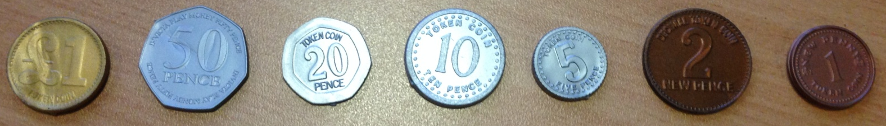
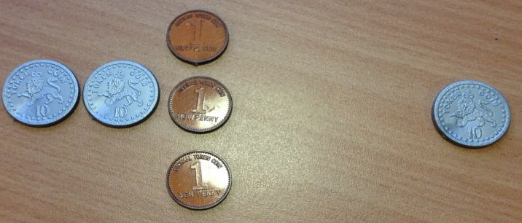

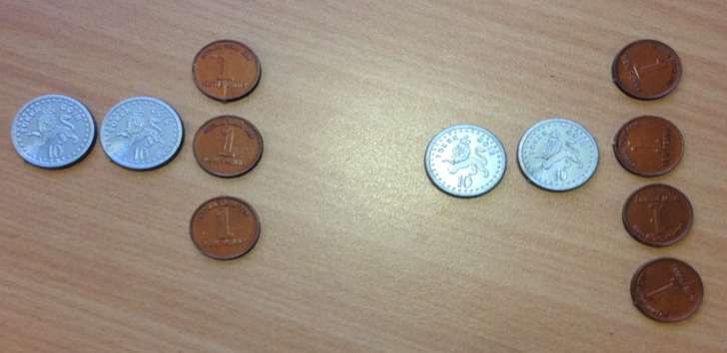

23+10=33
23+24=47

Slide 40

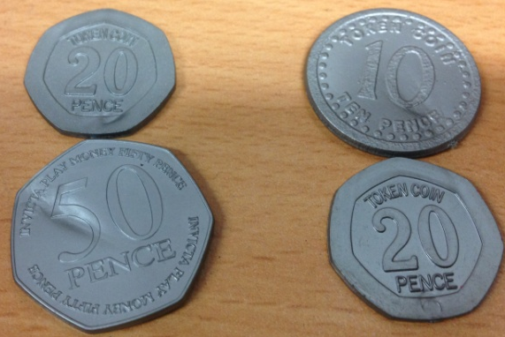
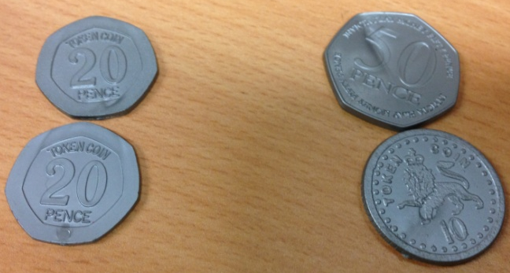
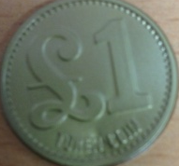
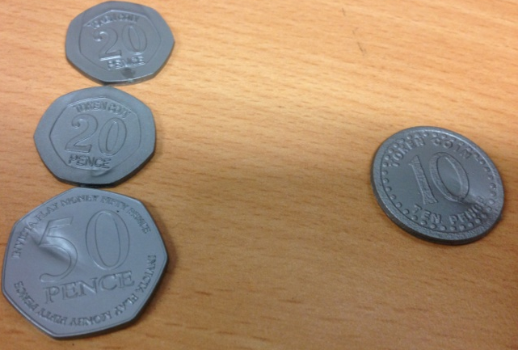
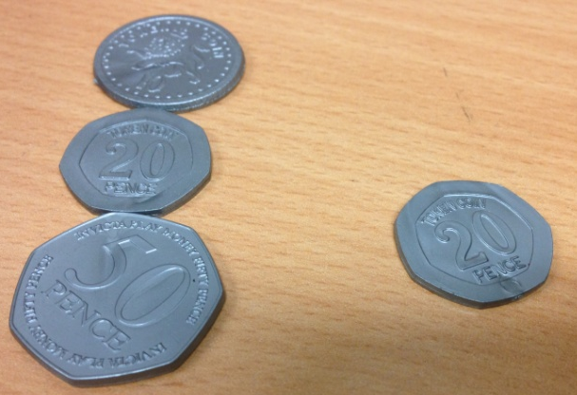
40p+60p=£1.00
70p+30p=£1.00
90p+10p=£1.00
80p+20p=£1.00

Slide 41
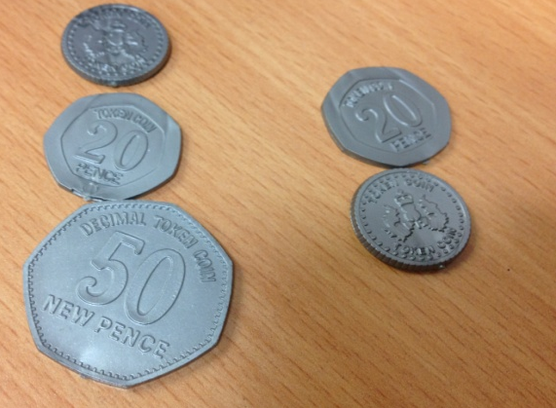
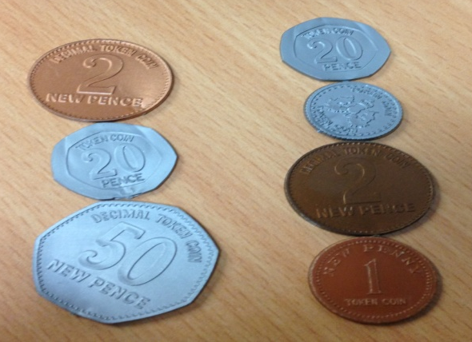
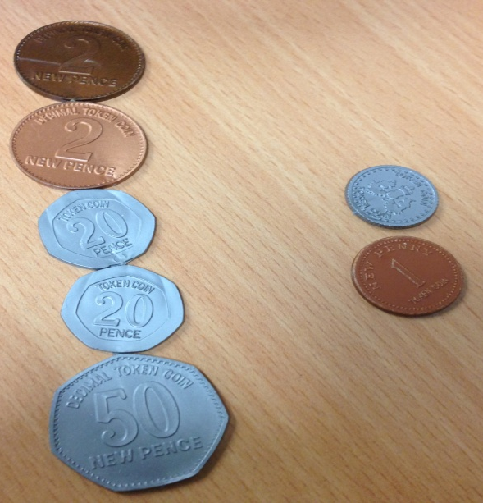
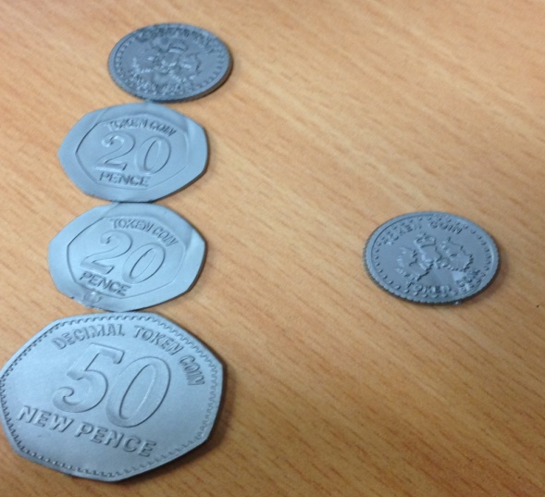
75p+25p=£1.00
72p+28p=£1.00
95p+5p=£1.00
94p+6p=£1.00

