Slide 1
Covid-19
Rules and Regulations for staff to keep safe around school
4.1.22

Slide 2
Essential measures include:
a requirement that people stay at home if they:
are ill with virus symptoms
have tested positive, even if asymptomatic
have been advised by NHS Test and Trace to do so
are required to self-isolate for travel-related reasons
robust hand and respiratory hygiene
enhanced cleaning and ventilation arrangements
active engagement with NHS Test and Trace
formal consideration of how to reduce contacts and maximise distancing between those in school wherever possible if outbreak occurs
minimise the potential for contamination so far as is reasonably practicable

Slide 3
Control measures
You should:
1. Ensure good hygiene for everyone.
2. Maintain appropriate cleaning regimes.
3. Keep occupied spaces well ventilated.
4. Follow public health advice on testing, self-isolation and managing confirmed cases of COVID-19.

Slide 4
Good Hygiene:
1. Ensure good hygiene for everyone
Hand hygiene
Frequent and thorough hand cleaning should now be regular practice. You should continue to ensure that pupils clean their hands regularly. This can be done with soap and water or hand sanitiser. After play, after lunch etc.
Respiratory hygiene
The ‘catch it, bin it, kill it’ approach continues to be very important.
The e-Bug COVID-19 website contains free resources for you, including materials to encourage good hand and respiratory hygiene.
Use of personal protective equipment (PPE)
Most staff in schools will not require PPE beyond what they would normally need for their work. The guidance on the use of PPE in education, childcare and children’s social care settings provides more information on the use of PPE for COVID-19.
ECM Trust are recommending use of masks in classes with positive cases and when walking around school.

Slide 5
2. Maintain appropriate cleaning regimes, using standard products such as detergents
You should put in place and maintain an appropriate cleaning schedule. This should include regular cleaning of areas and equipment (for example, twice per day), with a particular focus on frequently touched surfaces.
PHE has published guidance on the cleaning of non-healthcare settings.
Use of spray:
School will continue with the spray and wipe down hotspots, ensuring children are washing hands. Children’s toilets to be sprayed regularly, limit numbers and use own phase toilet. Staff to use this especially in communal areas and toilets still.

Slide 6
3. Keep occupied spaces well ventilated
When your school is in operation, it is important to ensure it is well ventilated and that a comfortable teaching environment is maintained.
You should balance the need for increased ventilation while maintaining a comfortable temperature.
When using the hall ensure windows are open and doors ajar.

Slide 7
Follow public health advice on testing, self-isolation and managing confirmed cases of COVID-19
Pupils, staff and other adults should follow public health advice on when to self-isolate and what to do. They should not come into school if they have symptoms, have had a positive test result or other reasons requiring them to stay at home due to the risk of them passing on COVID-19 (for example, they are required to quarantine).
Staff with symptoms should get tested as soon as possible and return when receiving a negative result.

Slide 8
Before even entering the building you MUST:
Ensuring that pupils, staff and other adults do not come into the school if they have coronavirus (COVID-19) symptoms or have tested positive in at least the last 7/10 days and ensuring anyone developing those symptoms during the school day is sent home and get a test, are essential actions to reduce the risk in schools and further drive down transmission of coronavirus (COVID-19).

Slide 9
If taking Part in the Lateral Flow Testing:
Staff taking part in the lateral flow testing will take tests on a Sunday morning and a Wednesday evening.
Results to be reported to school.
Report to the DFE.
Be responsible for ensuring you collect the test packs when you are down to 4.
LFTs to be used daily in a contact or increased number of positive cases.

Slide 10
Entering the building:
To sign in, please use the new electronic machine, remembering to download the app ideally to reduce anyone touching the screen other than student teachers/essential visitors. If necessary wipe before/after any touch. To start the system use back on finger.
When entering the school building wash hands with warm, soapy water immediately.
In communal areas and around school when mixing with other adults and pupils school leaders are advising wearing of a mask.

Slide 11
Wash Hands!

Slide 12
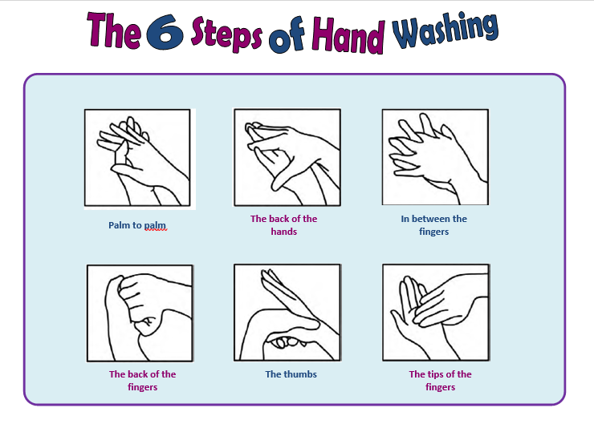
When to wash hands:
when they arrive at the school
• when they return from breaks
• when they change rooms
• before and after eating

Slide 13
Medicine in School
If a child has to take medicine, the parent will come to the reception and complete the form on the table. Leaving it there for staff to collect once left.
The medicine will be taken with the child to the class teacher.
The medicine will be taken by staff in that room, to the fridge in staffroom.
The office staff will inform the class teacher of the time, frequency and amount they have to take.
Medicine to be collected before home time and given to the child.

Slide 14
Use of lift
If a child needs to use the lift children and one adult in at a time to reduce contact.
Wipe the button before pressing, adult ONLY to touch buttons. Staff will already be wearing masks. Wipe inside buttons and use lift.
Once out of the lift, use the spray inside the lift, wipe down buttons.
Once in class, upon leaving school, wash hands.

Slide 15
If walking up and downstairs - Bannisters
If you are having to move from one floor to another: please use a wipe that is situated in the library and upstairs on the cabinet outside the toilet.
Place the wipe on the bannister and put hand on it to wipe whilst walking up/down so no cross contamination of others.
BEFORE pressing the green button, please use hand sanitizer.
Again place wipe in bin and wash hands in the room you are going to.

Slide 16
When leaving the room for break/lunch/home time
Wash/sanitise hands upon entry to the classroom, before lunch and after lunch.
Adult lead the group with a wipe for upstairs classrooms to wipe bannister whilst walking down.
Adult bringing them in have a wipe to wipe it as they lead the group up.
Wash hands upon entering the classroom.

Slide 17
Outdoor external equipment
The adventure playground, musical stage and sporting equipment needs to be sprayed after use.
A member of staff in the area to have a spray to use at end of breaks/lunch.

Slide 18
After lunch
Wash hands before lunch, wipe table where eating. If using picnic benches spray after each class.
Wash hands, adult leads them out, if upstairs wiping as they walk them down.
Wash hands upon entering the room.

Slide 19
Adult Toilets:
Wipes and spray will be outside the local toilets at the top of the stairs.
Before entering, spray handle, seat and taps.
Do your business.
When job complete, spray seat, wash hands and then spray taps and wipe hands.
Leave the wipes and spray outside, ready for next use.
Be mindful of social distancing, don’t all wait until bell, we will need to be in class on time.

Slide 20
Photocopier
Wipes will be in the room on the shelves, wipe down the screen and handles used to operate machines.
Complete the job and wipe once finished.
Wipe door handle if used to get in and out.

Slide 21
ICT Suite/Community Room
The ICT suite upstairs can be used for groups.
If it is to be used door should remain open for ventilation and all sprayed and wiped before and after use.
The air con MUST remain OFF at all times in the community room.

Slide 22
Someone ill in school:
For everyone with symptoms, they should avoid using public transport and, wherever possible, be collected by a member of their family or household.
If a pupil is awaiting collection, they should be left in a room on their own if possible and safe to do so. A window should be opened for fresh air ventilation if possible. Appropriate PPE should also be used if close contact is necessary, further information on this can be found in the use of PPE in education, childcare and children’s social care settings guidance. Any rooms they use should be cleaned after they have left.
The household (including any siblings) should follow the PHE and government guidance for households with possible or confirmed coronavirus (COVID-19) infection .

Slide 23
Someone with symptoms
If displaying ANY symptoms whatsoever, do NOT come to work, ring your line manager and arrange a test.
If a member of staff or child in a group were to displays symptoms during the school day, they will be immediately removed from the classroom and taken to an isolation room. They will be asked to book a test straight away.
School will keep in contact with you and parents should this event take place.
Staff member/Pupil isolates for 7/10 days if positive PCR and Track and Trace contact the close contacts.

Slide 24
Home Time
Collect belongings.
Wash hands.
Adults using the stairs, at front with a wipe, wiping bannister as children follow. Adult wipes banister upon re-entry to the school building.
Remember, if pressing the green access button use the hand sanitizer before pressing!
Wash hands upon entry/and when leaving the building.

Slide 25
Face coverings
Face coverings are no longer advised for pupils, staff and visitors either in classrooms or in communal areas.
However, we are strongly recommending that face masks are worn in communal areas.
Staff have the option to continue to wear if required in class especially if positive cases occur.
This guidance may change in the future depending on numbers.
The government has removed the requirement to wear face coverings in law but expects and recommends that they are worn in enclosed and crowded spaces where you may come into contact with people you don’t normally meet. This includes public transport and dedicated transport to school or college.

Slide 26
Attendance and remote learning:
School attendance is mandatory for all pupils of compulsory school age and it is a priority to ensure that as many children as possible regularly attend school.
Where a child is required to self-isolate or quarantine because of COVID-19 in accordance with relevant legislation or guidance published by PHE or the DHSC they should be recorded as code X (not attending in circumstances related to coronavirus). Where they are unable to attend because they have a confirmed case of COVID-19 they should be recorded as code I (illness).
For pupils abroad who are unable to return, code X is unlikely to apply. In some specific cases, code Y (unable to attend due to exceptional circumstances) will apply. Further guidance about the use of codes is provided in the school attendance guidance.
Not all people with COVID-19 have symptoms. Where appropriate, you should support those who need to self-isolate because they have tested positive to work or learn from home if they are well enough to do so. Schools subject to the remote education temporary continuity direction are required to provide remote education to pupils covered by the direction where their attendance would be contrary to government guidance or legislation around COVID-19.
You should maintain your capacity to deliver high-quality remote education for the next academic year, including for pupils who are abroad, and facing challenges to return due to COVID-19 travel restrictions, for the period they are abroad.
The remote education provided should be equivalent in length to the core teaching pupils would receive in school.

Slide 27
School meals
You should continue to provide free school meal support to any pupils who are eligible for benefits-related free school meals and who are learning at home during term time.
More information on providing school meals during the COVID-19 pandemic is available.

Slide 28
Inspection
For state-funded schools, it is intended that Ofsted will return to a full programme of routine inspections from September 2021 and will aim to inspect every state-funded school within the next 5 academic years. This will mean an extension of up to 6 terms in the inspection interval for those schools not inspected since the start of the pandemic. Regulations will give effect to these arrangements. Within the 5-year period, Ofsted will continue to prioritise schools most in need of inspection, particularly those with the lowest Ofsted grades. It will also prioritise outstanding schools that were previously exempt from routine inspection that have gone the longest without a visit.

